Slide 1
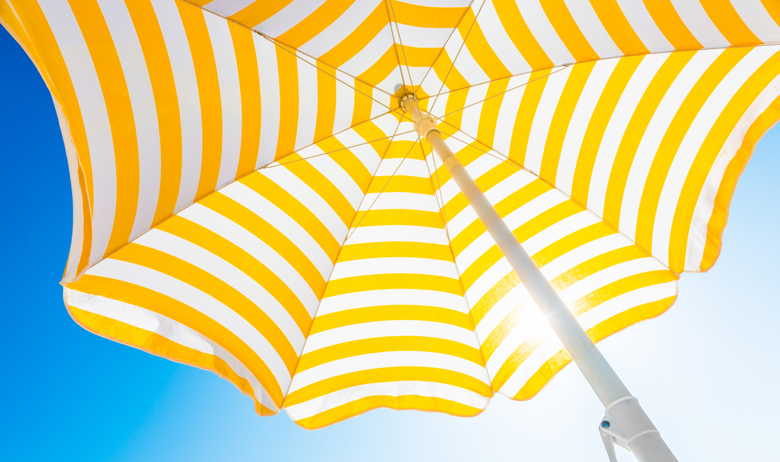
Your Sun
Protection
Strategy
PRESENTED BY
(NAME) & The Skin Cancer Foundation

Slide 2


Slide 3

The Skin Cancer
Foundation
For more than 40 years, we have been fighting the world’s
most common cancer with medically reviewed content and
programs that are trusted by millions.
We empower people to take a proactive approach to
daily sun protection and the early detection and treatment
of skin cancer.
Your Sun Protection Strategy — 3
The Skin Cancer Foundation is a 501(c)(3) charity supported by donations, grants and sponsorships.
Notes:
• And I want to make clear, we [or The Skin Cancer Foundation ] are not anti-fun-in-the-sun! We want you to get outside.
• Studies show that being among trees, near water, just out in nature lowers blood pressure and stress hormones, gets you moving and makes you feel happy. So get out there, but keep your skin safe. We’ll tell you how.

Slide 4




A Few Facts
Your Sun Protection Strategy — 4
More people are
diagnosed with skin
cancer in the U.S.
than all other cancers
combined.
In the U.S., more than
9,500 people are
diagnosed with skin
cancer every day.
More than two people
die of the disease
every hour.
At least one in five
Americans will
develop skin cancer by
the age of 70.
Anyone can get
skin cancer.
Notes:
First, a few facts about skin cancer.

Slide 5

Protecting your
skin from the sun
is the key
to prevention!
Your Sun Protection Strategy — 5
Notes:
Luckily, skin cancer is the cancer you can PREVENT! Protecting your skin from the sun is the key.

Slide 6

The sun
sustains life and
feels good,
but it can be
your skin’s
worst enemy.
Your Sun Protection Strategy — 6
To understand why, we need to observe
a moment of SCIENCE…

Slide 7
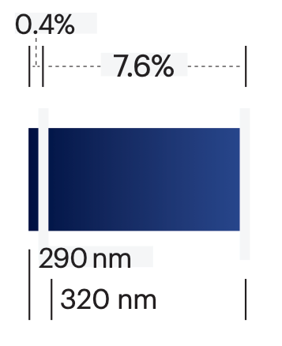
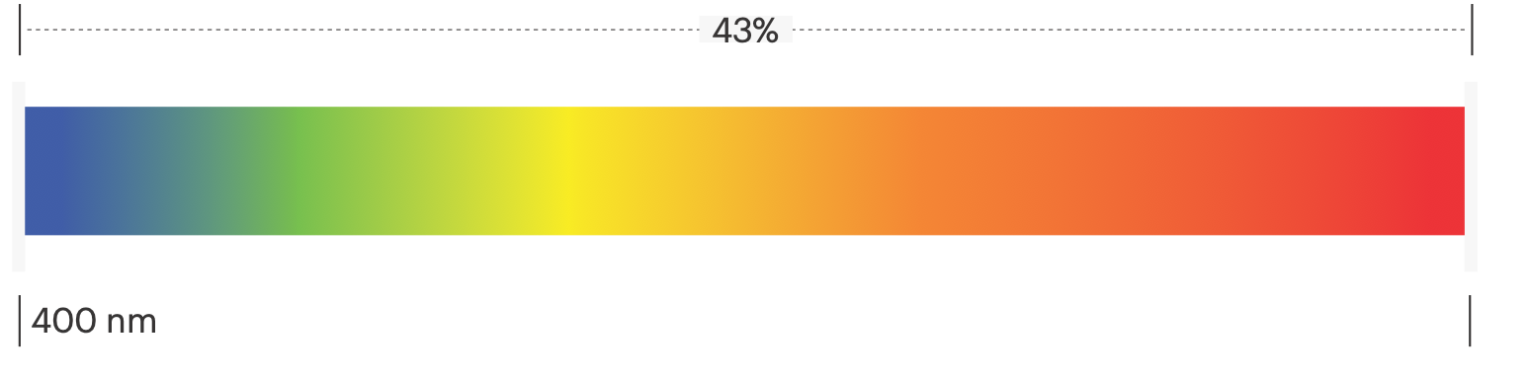
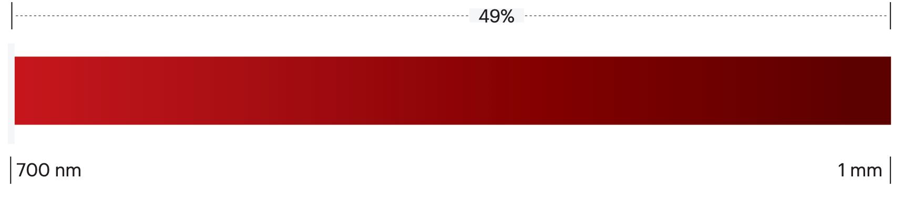

The Spectrum 101
Approximate Percentages of Solar Radiation Reaching Earth’s Surface*
Your Sun Protection Strategy — 7
UVB
290 to 320 nm
Known for: Sunburn
UVA
320 to 400 nm
Known for: Tanning and premature
signs of aging
Visible Light
400 to 700 nm
Known for: Generating free radicals
Infrared
700 nm to 1 mm
Known for: Penetrating deeper into the skin
*Sources on percentages vary. Chart does not include gamma rays, X-rays, UVC, microwaves or radio waves.
Notes:
• This graph represents ALL the stuff the sun puts out that reaches us here on Earth.
• While this is an electromagnetic spectrum, it’s all basically light. That light travels in wavelengths [MAKE PARABOLIC HAND MOTION] that are measured in NANOMETERS.
• A nanometer is one BILLIONTH of a meter, so the wavelengths on the left side are super tiny and the ones on the far right are a little larger.
• [CAN SAY IF YOU HAVE A SCIENCE AUDIENCE] For you science enthusiasts out there, yes, there are gamma rays and UVC rays to the left side of our spectrum that don’t reach us.
• UVC rays are deadly and do not reach us on earth, but artificial UVC is used in germ-cleaning machines you may have heard about during the pandemic.
• To the right of our spectrum are the larger microwaves and radio waves [which also don’t reach us].

Slide 8
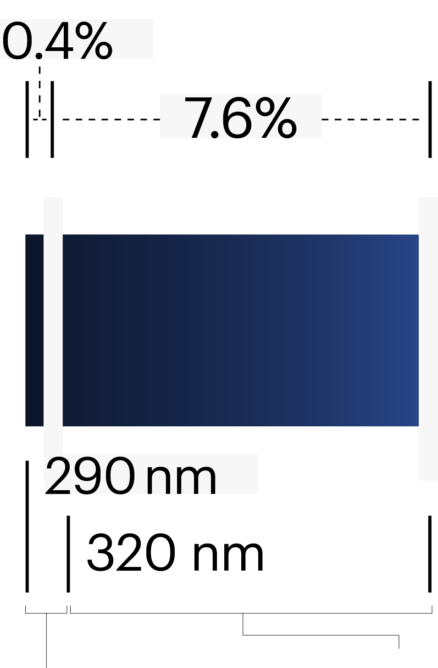
Ultraviolet (UV) Light
Is Our Main Focus!
UVB rays cause sunburn and damage to DNA in
skin cells, which can lead to skin cancer.
UVA rays cause tanning and also contribute to
skin cancer and signs of aging.
Your Sun Protection Strategy — 8
Damage to DNA in skin cells starts within minutes
of exposure to both kinds of UV light.
Your immune system repairs some damage,
but over time, remaining DNA damage can cause
mutations that lead to skin cancer.
UVB
290 to 320 nm
Known for: Sunburn
UVA
320 to 400 nm
Known for: Tanning and premature
signs of aging
Notes:
• UVB: This tiny percentage of the spectrum was the main focus of sunscreen protection for decades. It is related to SPF, which we will talk about later.
• UVA rays are prevalent in all kinds of weather and even penetrate glass. They’re used in tanning beds, too. They relate to “broad-spectrum” protection, which we will talk about later.
• Having 5 or more sunburns doubles your risk for melanoma, a dangerous type of skin cancer.
• It’s not just those big days at the beach or ballgame that cause trouble.
• Every time you run out to get the mail, walk the dog or commute to work without sun protection adds to the damage that can lead to skin cancer (as well as leathery skin, dark spots and wrinkles).

Slide 9
The bluish part, high-energy visible, or HEV light,
causes free radicals and inflammation that can
damage DNA in skin cells.
Visible Light
It can also contribute to wrinkles and signs of aging.
Many experts believe you should protect your skin
and eyes from HEV, which is also emitted by computers, smartphones and other devices.
Your Sun Protection Strategy — 9
Visible Light
400 to 700 nm
Known for: Generating free radicals
Notes:
• Visible light is the ROYGBIV part of the spectrum you know from seeing rainbows.
• The larger sections of this spectrum are also a major focus of research in the sun care industry.
• Some sunscreen products and eyewear now claim to protect skin against blue or visible light.
• However, there currently are no testing standards to measure the degree of visible light protection.

Slide 10
A segment of infrared called IRA penetrates deeply
into the skin and can generate free radicals. It may even
intensify damage caused by UV.
Infrared
More research is needed to determine how much our
skin needs protection from these wavelengths and how
to adapt sun protection products to do that.
Your Sun Protection Strategy — 10
Infrared
700 nm to 1 mm
Known for: Penetrating deeper into the skin
Notes:
• Infrared radiation (IR) starts at the outer red edge of our visible light and has the longest wavelengths in this spectrum.
• While infrared is invisible to human eyes, you can sometimes feel it as heat.

Slide 11



Everyone
Needs a
Sun Protection
Plan!
Your Sun Protection Strategy — 11

Slide 12

No single method of
sun defense can protect
you perfectly.
The best path to beautiful, healthy skin is to adopt
as many of these steps as possible and make them
daily habits everywhere you go, all year long.
Your Sun Protection Strategy — 12
Notes:
[BRING HANDS TOGETHER AND INTERLOCK FINGERS] Remember that BEAUTIFUL and HEALTHY go together as benefits when you protect your skin from the sun!

Slide 13

Cover It Up!
Clothing can provide a great barrier against the sun’s rays. Its protection is consistent and doesn’t wear off like sunscreen.
Your Sun Protection Strategy — 13
Many new fabrics offer high-tech protection and breathability.
The more skin you cover, the better!
A wide-brimmed hat can shade your eyes, face, ears and neck.
Wear UV-blocking sunglasses to protect
your eyes and the skin around them.
Notes:
• I like to start with clothing, because it has been used throughout history to protect your skin from all of the sun’s rays.
• I you think about how a body part that has always been covered by clothing looks from, say, your hand or forearm, you see a BIG difference!
• The Skin Cancer Foundation recommends hats with at least a 3-inch brim all around for best protection.
• Baseball caps are common, especially at spectator sports and are better than nothing. But that leaves much of the face, ears and neck exposed, so sunscreen is a must and should be reapplied every two hours.

Slide 14
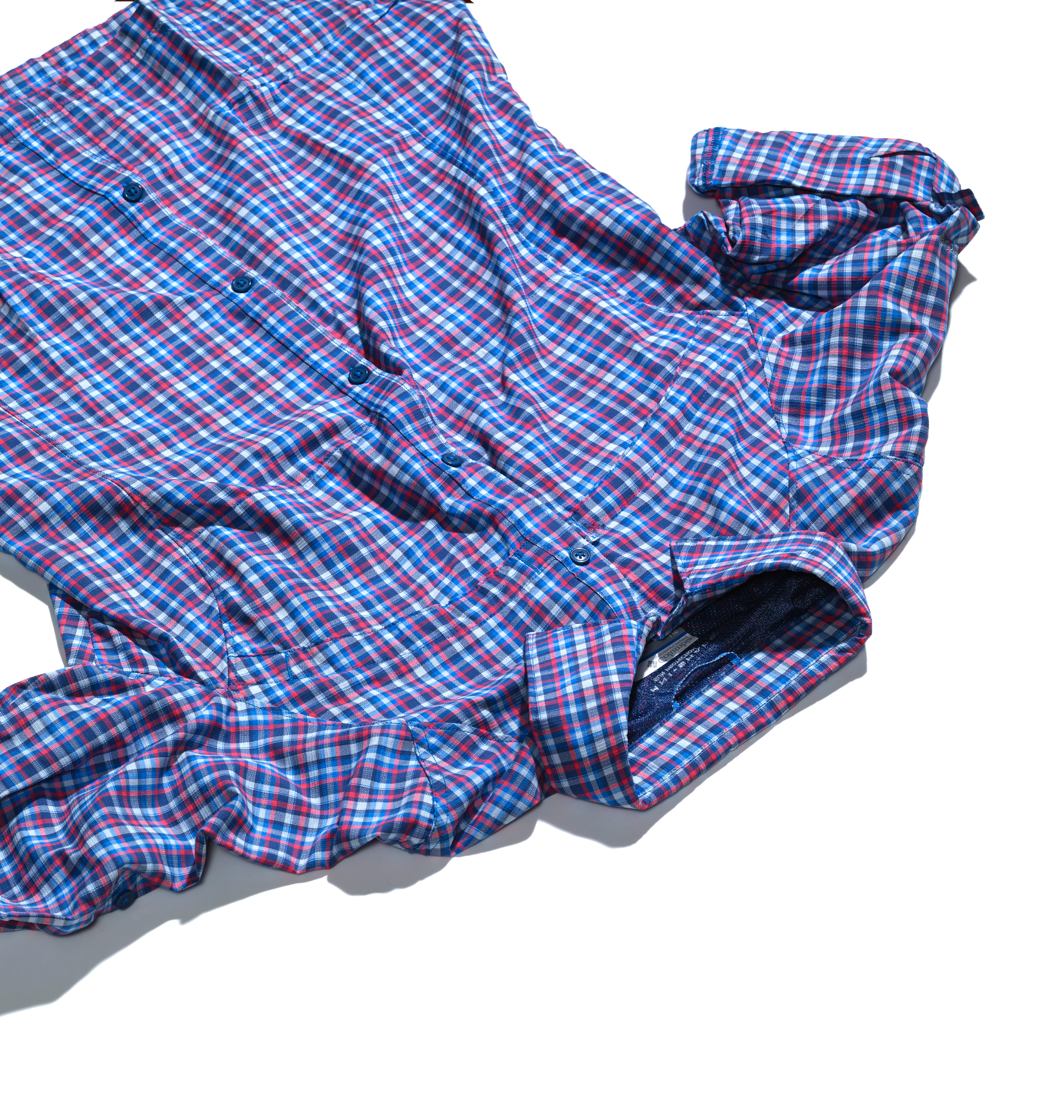
What Does
UPF Mean?
Look for UPF, which stands for ultraviolet
protection factor, on labels for clothing,
hats and fabrics.
Your Sun Protection Strategy — 14
The number indicates what fraction of the
sun’s UV rays can penetrate the fabric.
A shirt labeled UPF 50, for example, allows just 1/50th of the UV radiation to reach your skin.
The pitfall: Any clothing leaves some
skin exposed, so you need sunscreen, too.
Don’t forget to apply it to your hands, especially after washing them.
Notes:
• Darker, brighter and tightly woven fabrics generally have a higher UPF than lighter ones, even if not labeled. Denim, for example, or a winter coat, naturally has a high UPF!

Slide 15

Play in the Shade
Put shade on your radar! It’s one of the easiest and most important forms of sun protection.
Your Sun Protection Strategy — 15
Shade is especially important between
10 AM and 4 PM, the peak hours of
sun intensity.
The pitfall: Shade isn’t a perfect shield.
Some UV can pass through leaves and branches, hit your skin from the side and
reflect off water, sand, glass and concrete.
Notes:
• Walk on the shady side of the street, sit under an awning or sun-protective umbrella, duck onto the covered porch at a pool party or even under a tree.
• Personal sun umbrellas, or parasols, have protected skin throughout history. When it’s hot outside, the breeze gets in and it feels cooler. There’s less glare in your eyes.
• A dark, tightly woven or reflective umbrella fabric usually offers better protection than a light, translucent one.

Slide 16

Shield the
Wee Ones
Infants: In the first six months, keep infants
out of the sun rather than use sunscreen on their sensitive skin.
Clothing should cover baby’s arms and legs. Don’t forget to use hats, sunglasses and
stroller sunshades.
Your Sun Protection Strategy — 16
Toddlers: You can apply sunscreen to
children starting at six months. Continue to
use protective clothing and a hat.
The pitfall: Unexpected exposure can
happen. Talk to caregivers in advance about sun protection.

Slide 17

Look Out for
Windows
Glass blocks UVB rays pretty well, but it
allows UVA rays to pass through.
This is true of windows at home, in your office, in your car and on airplanes, trains and buses.
Your Sun Protection Strategy — 17
Protect yourself and your family with hats, clothing, sunglasses and sunscreen.
Consider having UV-protective window film applied to windows, in your car or at home.
The pitfall: You need to plan ahead before traveling and make sure you have sunscreen on and protective clothing with you.
Notes:
• Car windshields are treated to shield drivers from most UVA, but side, back and sunroof windows usually aren’t.
• Drivers in the U.S. and countries with the driver’s side on the left have more skin cancers on the left side of the body — and vice versa.
• Airline pilots, crew members and even frequent travelers shave been shown to get more skin cancers than other people.

Slide 18
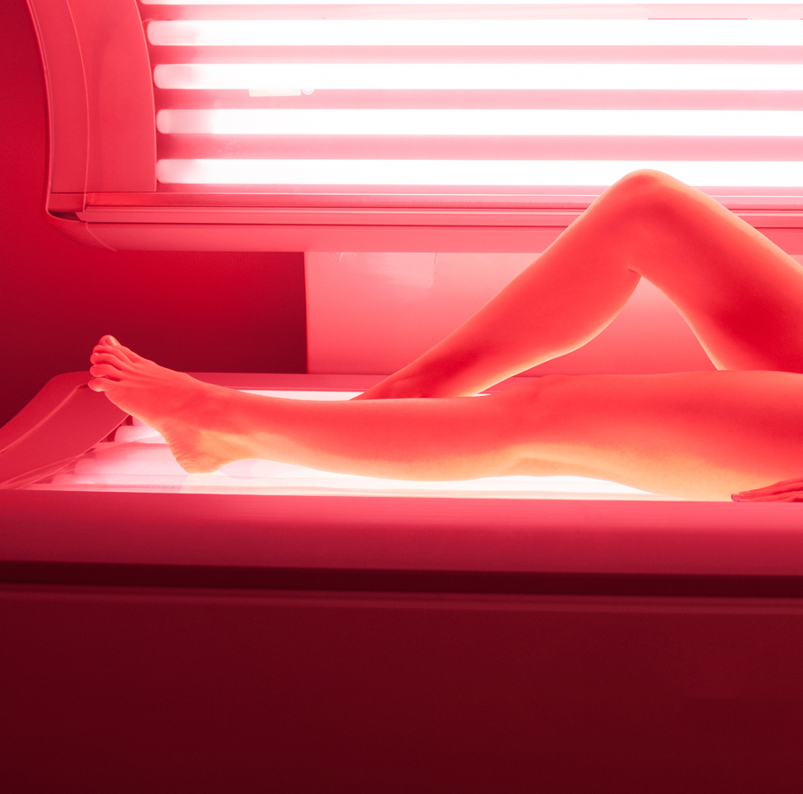
Say No to
Tanning Beds
Don’t use a tanning bed — ever.
Indoor tanning (even once) raises the risk
of all kinds of skin cancer.
Your Sun Protection Strategy — 18
Using a tanning bed before age 35 increases your risk of melanoma by 75 percent.
The pitfall: While some states prohibit minors from using tanning beds, or require parental consent, other states have not restricted
access. Peer pressure can be hard to resist.
Notes:
• We know of patients who have gotten dangerous melanoma in their 20s, or even in their teens, from using tanning beds. It’s never worth it!

Slide 19
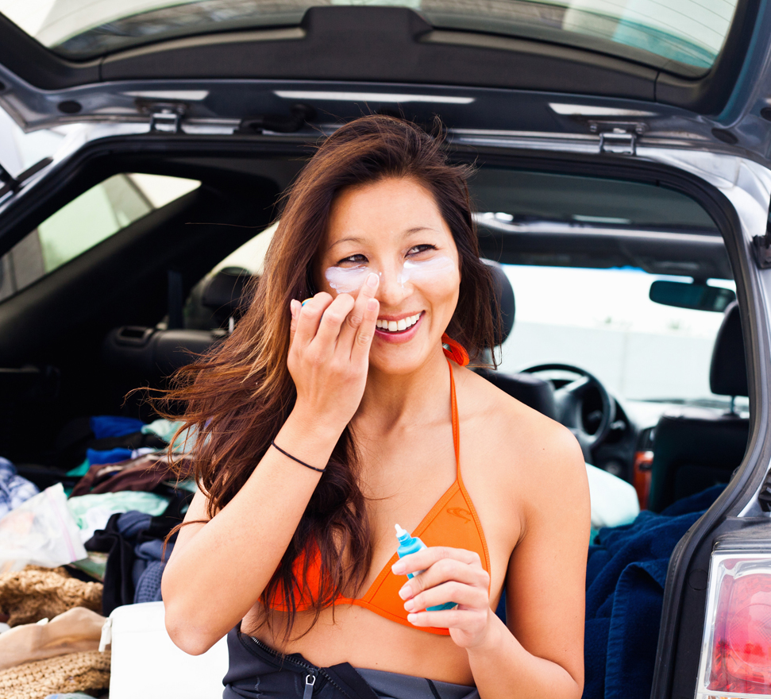
Know Your
Sunscreen
Sunscreens come in many
formulations and delivery methods, and it can take trial and error to find the one you like best. Whether it’s
a sport spray, an easy-to-use stick or
a rich moisturizer with antiaging
ingredients, the best sunscreen is
the one you will use every day.
Your Sun Protection Strategy — 19

Slide 20
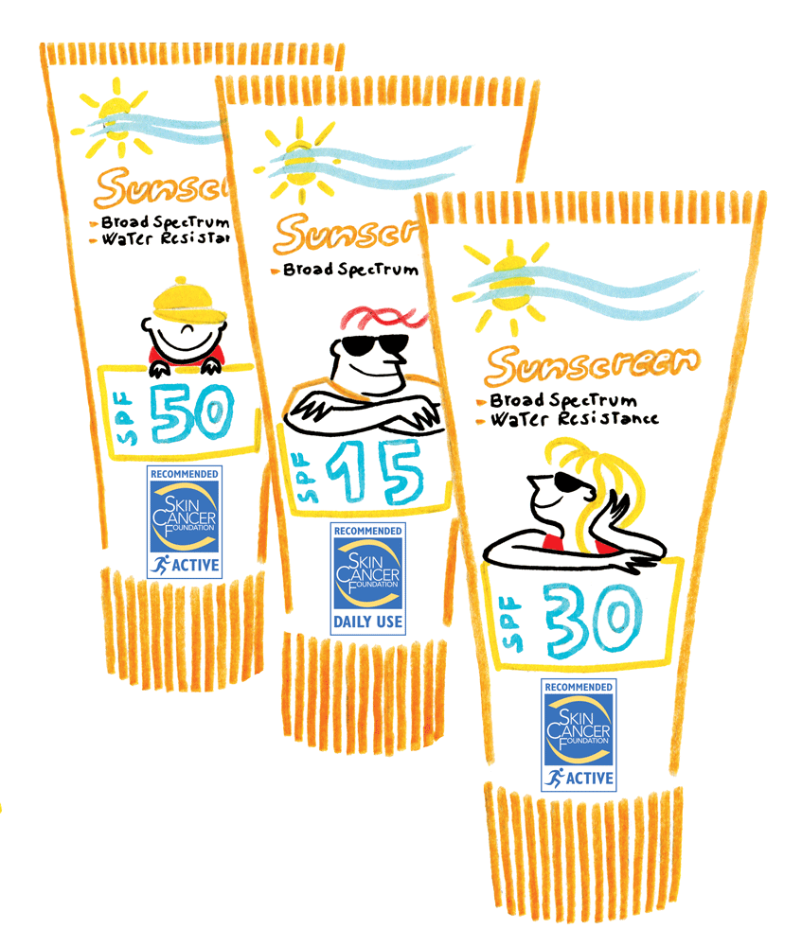

SPF Stands for
Sun Protection Factor
The number tells you how long the
sun’s UVB rays would take to redden your
skin when using a particular sunscreen
compared with the amount of time without
sunscreen. So if you use an SPF 15 product
exactly as directed (applied generously
and evenly, and reapplied after two hours
or after sweating or swimming),
it would take you 15 times longer
to burn than if you weren’t
wearing sunscreen.
Your Sun Protection Strategy — 20
Notes:
• SPF is related to those UBV rays you saw on the far left side of our spectrum, the ones representing that tiny, but very dangerous, part of the spectrum!
• Most people think they know what SPF means, but it is really an amount of time that is personalized to each person.
• Some people’s skin gets red within 3 minutes, so an SPF 15 would only protect you from sunburn for 45 minutes!
• Plus, you have to slather on enough product enough to make it effective. (more about that in a minute.)

Slide 21

Broad Spectrum
The words “broad spectrum”
on a label indicate that the
sunscreen contains
ingredients that effectively
protect against UVA rays
as well as UVB.
Your Sun Protection Strategy — 21
Notes:
• So “broad spectrum” protection protects your skin from both parts of the UV part of the spectrum we showed you earlier.

Slide 22

Water Resistance
While sunscreens can’t
claim to be waterproof, they
can be labeled water resistant
for either 40 or 80 minutes.
Yes, you can burn even when
you’re in the water, so
reapplying is key!
Your Sun Protection Strategy — 22
Notes:
• If you towel off after being in the water, you wipe off some of that protection, so you need to reapply, even if it’s been a short time since you jumped in!

Slide 23
Sensitive Skin
Products containing
zinc oxide and titanium dioxide,
sometimes referred to as
mineral or physical formulas,
may be less likely to cause
skin irritation in people who
have sensitive skin.
Your Sun Protection Strategy — 23
Notes:
[IF YOU WANT TO MENTION OR IF CONTROVERSIES COME UP IN DISCUSSION]
• Zinc and titanium are ingredients that some people believe are better for the environment and may be less controversial [i.e., FDA GRASE distinction, absorption into bloodstream, coral reefs, etc.] More research is needed, but mineral products are widely available for those who prefer them.

Slide 24
The Pitfall
Most people don’t apply
sunscreen exactly as
directed. They may not apply
it liberally enough, might
miss spots and may forget
to reapply regularly.
Slather it on!
Your Sun Protection Strategy — 24
Notes:
• For example, if you’re using an SPF 30 product but only apply 1/3 of the recommended amount, it’s like using an SPF 10 and won’t protect your for long!
• One dermatologist we know says you should apply sunscreen like paint, as if you were painting a house and trying to to get good coverage. Then rub it in!
• If you use a spray, spray till it really glistens on the skin, then rub it in well.

Slide 25
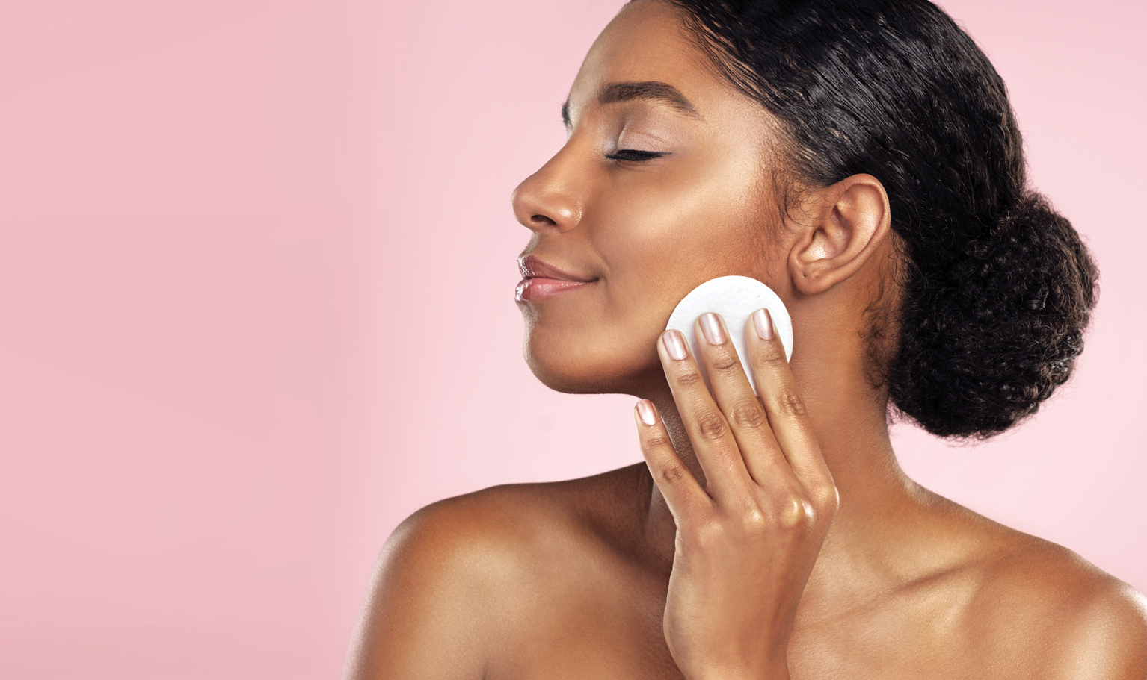

Making
Sunscreens
More
Appealing
Your Sun Protection Strategy — 25

Slide 26

Researchers in the personal
care and cosmetic industry have worked hard to create
innovations for better sun
protection products that appeal to every need — with beauty and antiaging benefits, too.
Your Sun Protection Strategy — 26
Enhanced formulas and formats appeal to every age, skin type and skin tone. These include:

Slide 27
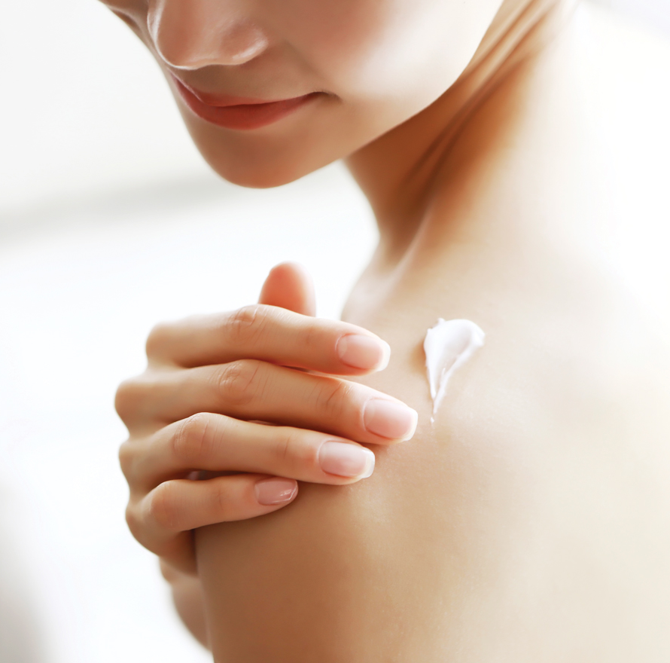
Sunscreen
Innovations
Tinted mineral-based formulas that may
protect against more than just UVA and UVB, and help your skin look good!
Your Sun Protection Strategy — 27
Antioxidants to help fight free radicals.
Better texture, such as for oily or acne-prone skin, or a dry feel for athletes, or an elegant moisturizing feel.
Better performance, so a product may
stay on the skin longer, be more water or
heat resistant, or not migrate into your eyes.
Notes:
• The iron oxides used to tint products may protect against a broader part of the spectrum than just UV. It couldn’t hurt!
• More and more men are using tinted products; they’re not makeup, but they do even out skin tone and look good on anyone.
• Free radicals are harmful oxidation; topical antioxidants in products may help fight them. [Eating colorful fruits and vegetables high in antioxidants may help, too!]
• So many new types of products are out there; experiment until you find the perfect ones for you!

Slide 28
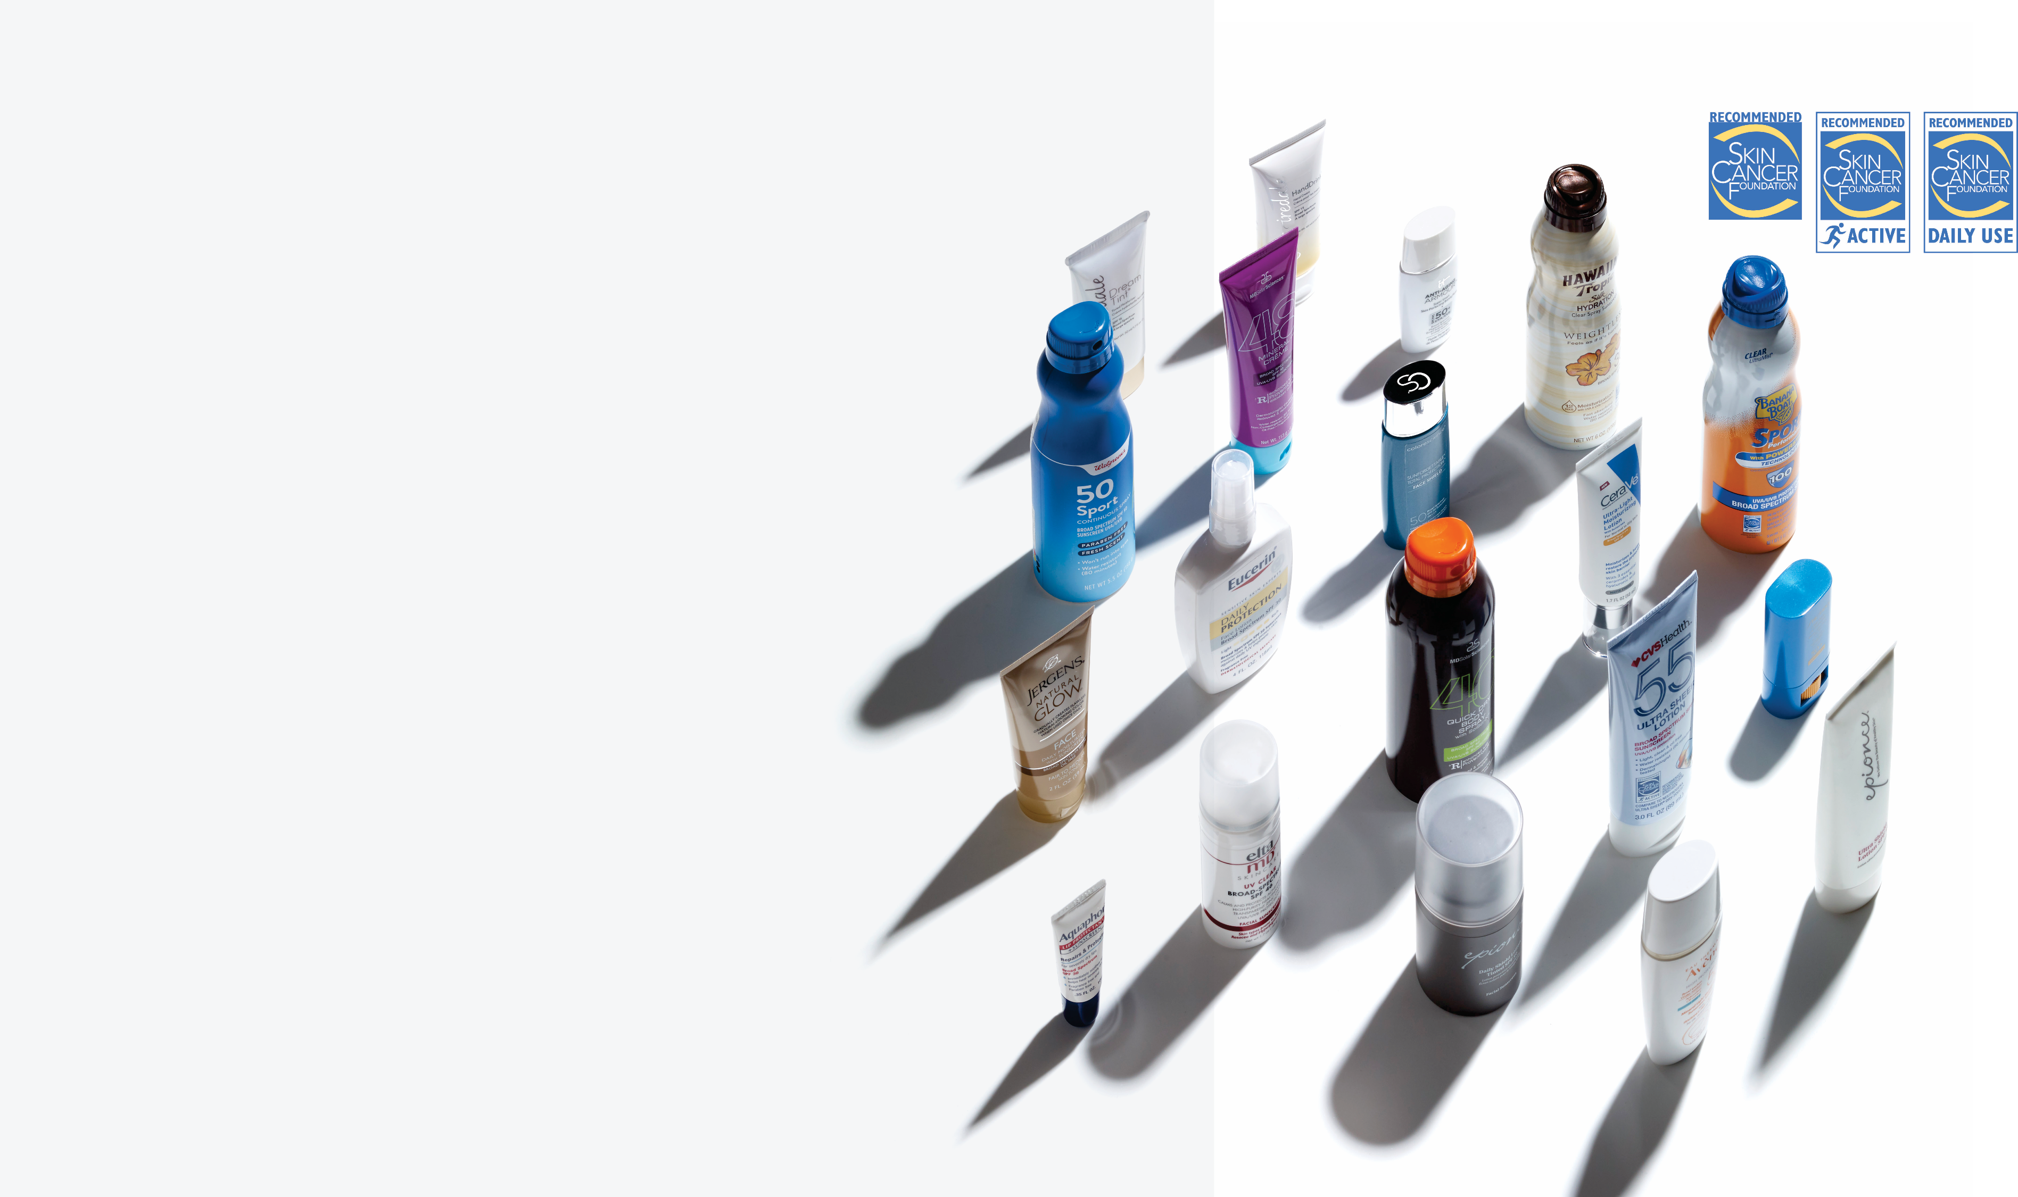
Stay Safe Out There!
The bottom line is that you need several
types of sun protection to safeguard your skin. Do everything you can!
Many products that meet our criteria for
safe and effective UV protection have
earned The Skin Cancer Foundation Seal of Recommendation.
Your Sun Protection Strategy — 28
Look for clothing, hats, sunglasses, sunscreens, moisturizers, cosmetics, awnings, umbrellas, window film and more that carry the Seal.
You can find these products on the
Sun Protection Product Finder at
SkinCancer.org/recommended-products.
© 2020 The Skin Cancer Foundation. All rights reserved.
Notes:
So get outside, stay healthy and protect your skin!

Slide 29






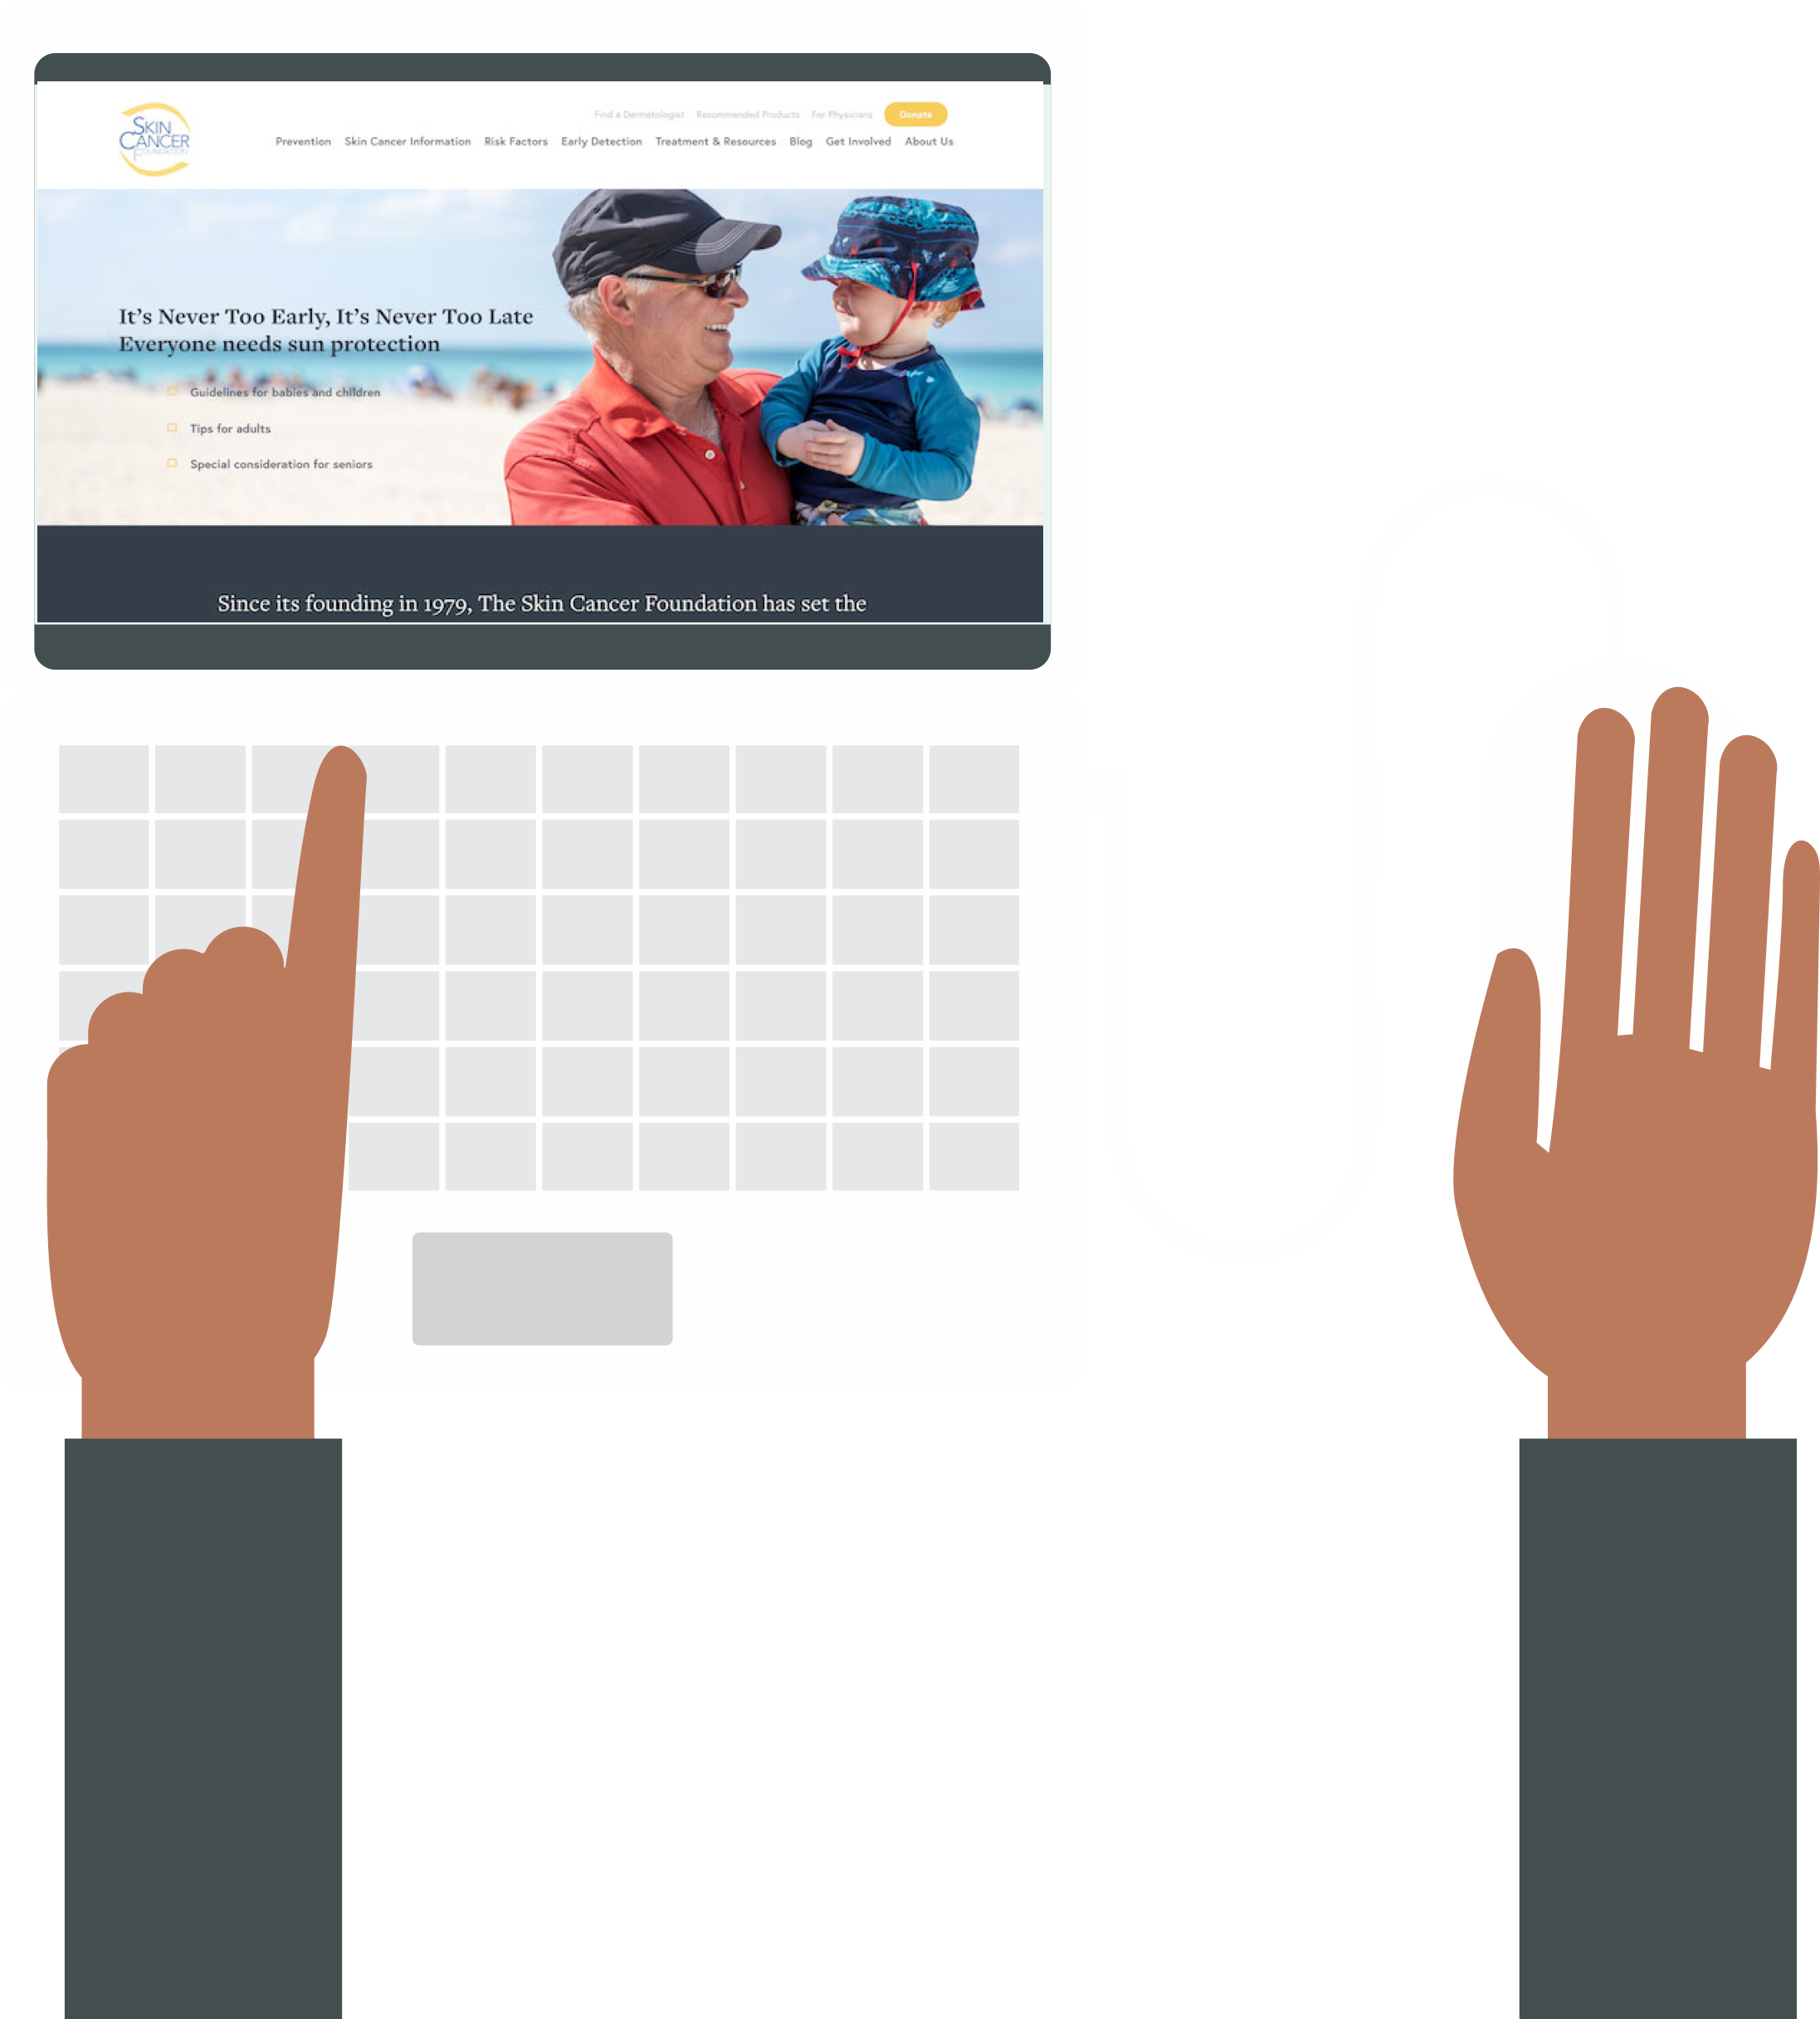


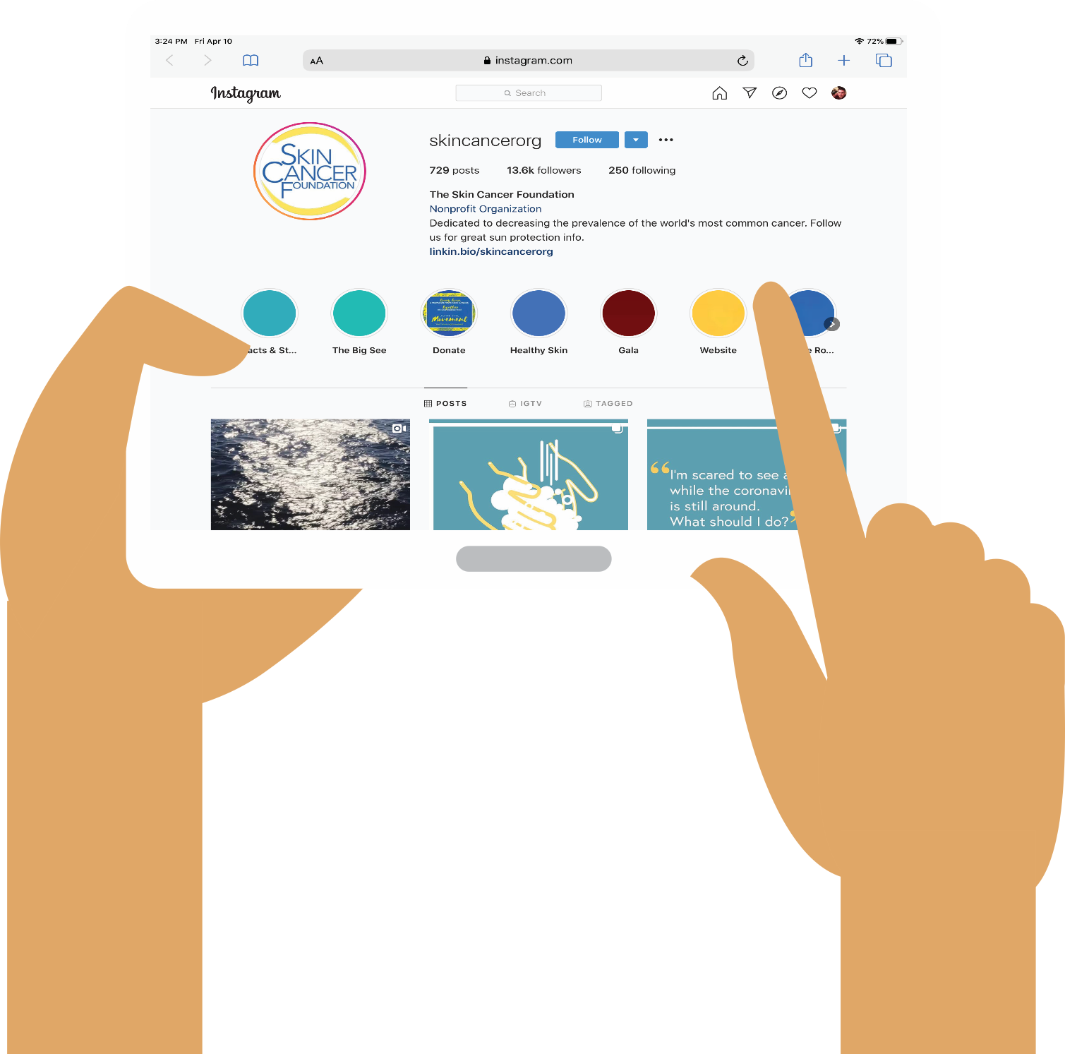

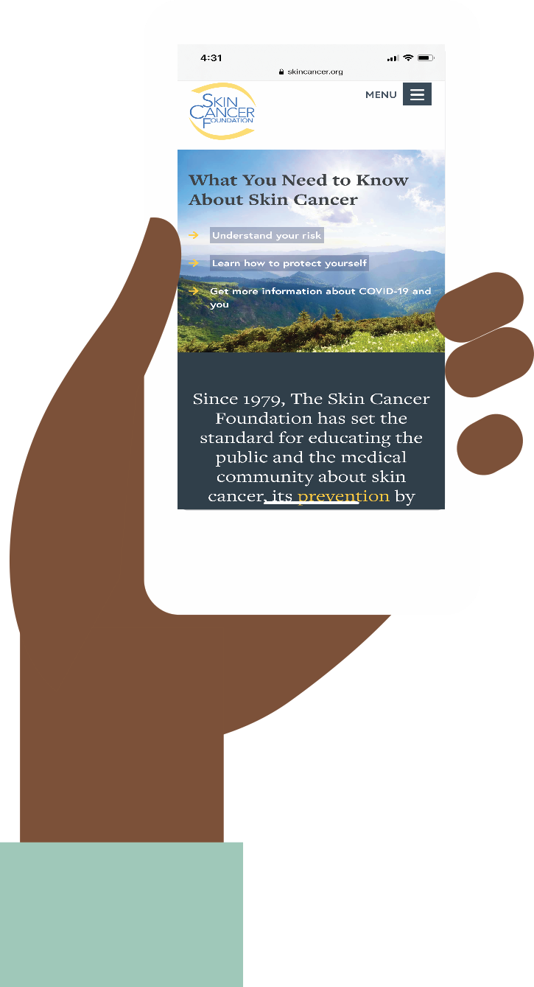


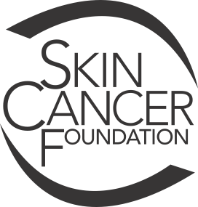
Thank you!
Looking for the latest, best
skin cancer information online?
The Skin Cancer Foundation has it.
SkinCancer.org
skincancerfoundation
SkinCancerOrg
skincancerorg/

